Slide 1
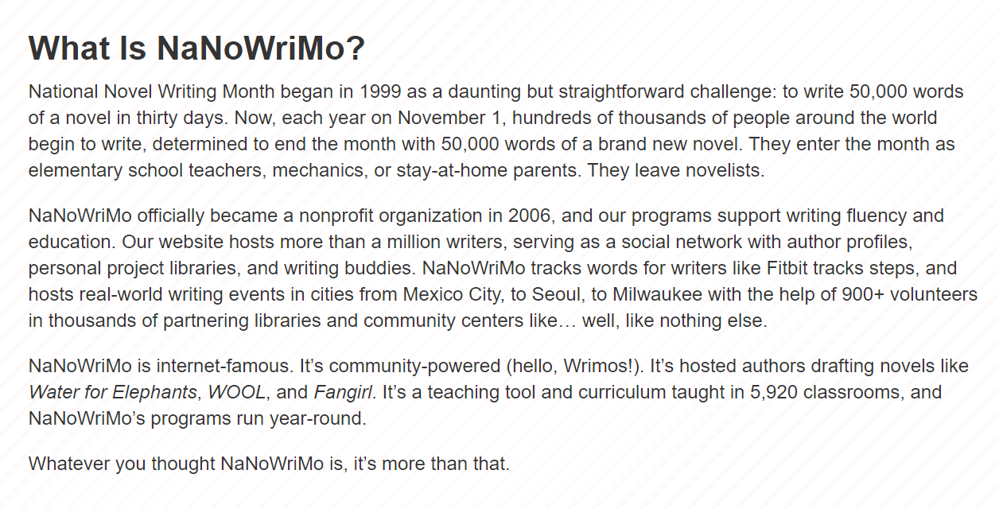
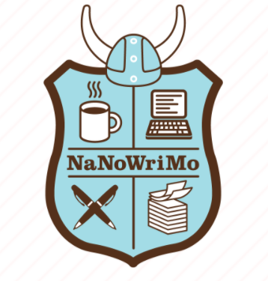
The NaNoWriMo Kickoff Meeting

Slide 2
NaNoWriMo’s Challenge
50,000 words in 1 month (November)
Approximately 11,655 words per week
Bestselling Titles:
Water for Elephants by Sarah Gruen
The Night Circus by Erin Morgenstein
Cinder, Scarlet, and Cress by Marissa Meyer
Fangirl by Rainbow Rowell
Wool by Hugh Howey
Side Effects May Vary by Julie Murphy

Slide 3
Today’s ActiviTea
Discord Link: https://discord.gg/xJKG4m9E
Begin writing some long-form fiction!
Write in any genre… or subvert genre entirely. This is your project.
Set your own goals if you want (we know ~12,000 words a week is kind of a lot).
Follow along with us on our Discord.

Slide 4
Teabags
Discord Link: https://discord.gg/xJKG4m9E
Having trouble getting started?
Start with an event or entity the main character witnesses, but does not understand (suspicious behavior, a secret being kept, a monster in the dark). Reveal pieces of the mystery as the story unfolds.
Someone is in love with someone. But it’s complicated because… (Very general romance startup. Have fun devising the challenges. Health condition? Love triangle? Rival families? PIRATES? SUPERPOWERS? Why is it not so easy for these two or more to be in love?)
Write about a crime or group of criminals. Start with the crime… or don’t, that’s cool too. Build the intensity, create the ensuing fallout. What’s the crime? Classic bank robbery? Sci-Fi dystopian graffiti (dang, I kinda want to write this one)? Steampunk hitman? Theft of a valuable artifact?
Do your own thing! Do not feel like you have to take one of my prompts. I won’t be using one. And if you’ve already started: keep on chugging, my beautiful choo choo train.

